Slide 1


Inventory Management & Optimisation
Data-driven Supply Chain Management & Logistics
26% less capital · 95% availability
Group 2 · Topic 1 · by Divya Shori
25 November 2026 · github.com/divyashori-datascience/group2-topic1-scm-inventory-optimisation
1
Notes:
Welcome. Over the next minutes I show how we analysed fifteen years of stock movements, how we decided which articles belong on stock, and how we set reorder points from demand. Each part first shows how it was done technically, then what it means for the client. The headline: about 1.27 million less capital tied up, with 95 percent fill. All code, notebooks and the full report are in the repository on the slide.

Slide 2

Free 1.27M of capital
while raising availability
EXECUTIVE SUMMARY
−26%
95%
−34%
average stock vs 2021
fill rate, 97% on A-articles
capital vs today’s rules, same service
WHAT WE RECOMMEND
1
Clean the range
2
Stock by class
3
Set levels from demand
2
Notes:
Three numbers to remember. Average stock falls by 26 percent compared with 2021: 3.65 million instead of 4.92 million. Availability rises to 95 percent value-weighted fill, 97 percent on the A-articles. And compared with today’s reorder points, the same service needs about a third less capital. The recommendation in three steps: clean the range by de-listing 427 articles and running down idle stock; stock by class, so only Runners and selected Repeaters are held; and set every reorder point from demand, recalculated monthly. All results come from a simulation of test year 2021 on the 1,751 inventory articles; values are in the dataset’s anonymised currency units.

Slide 3

Capital lockup rose from
16% to 27% of revenue
THE CHALLENGE & OUR APPROACH
Three questions, each building on the one before
Capital in stock, % of revenue
1
2
3
2019
16%
PART 1 · DATA ANALYSIS
PART 2 · CLASSIFICATION
PART 3 · REORDER POINTS
Where does the capital sit?
Which articles belong on stock?
At what level should they reorder?
27%
2022
+11 points in three years
3
Notes:
The client’s problem: capital tied up in stock grew from 16 to 27 percent of revenue in three years. We answer three questions that build on each other. Part 1: where does the capital sit and how healthy is it? Part 2: which articles should be on stock at all? Part 3: at what level should those articles reorder? Part 1 findings define the Part 2 features, and the Part 2 classes decide which articles get a Part 3 reorder point. Every result comes from the 2.69 million stock movements, 2007 to 2022, covering 58,764 articles.

Slide 4
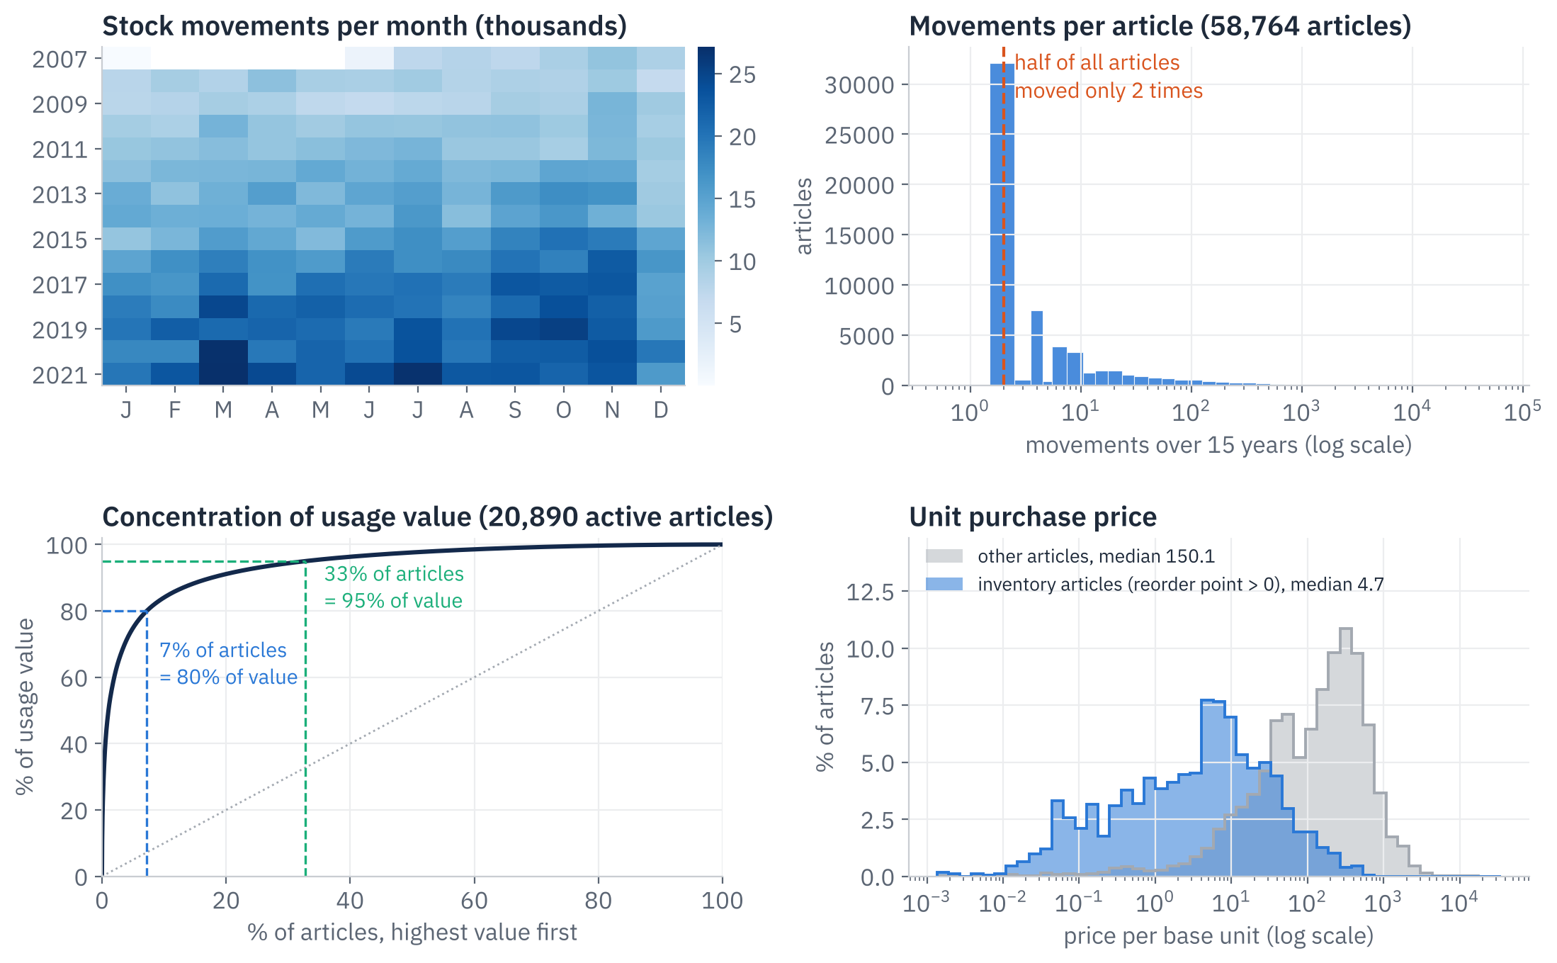
Growing activity,
a long tail, value in few articles
PART 1 · THE DATA AT A GLANCE
Why: understand the data before modelling it
more movements than in 2008
5×
of articles moved only twice
50%
of articles = 80% of value
7%
4
Notes:
Before any modelling, this is what the raw data looks like. Top left, a heatmap of movements per month: activity grew about five-fold, from 108 thousand movements in 2008 to 274 thousand in 2021, so rules set years ago are unlikely to fit today. Top right: the range has a very long tail; half of all 58,764 articles moved only twice in fifteen years, typically one receipt and one use. Bottom left, a Lorenz curve: value is highly concentrated; 7 percent of the active articles carry 80 percent of usage value and 33 percent carry 95 percent. That concentration is why we later segment by value for service levels. Bottom right: articles with a reorder point are cheap, high-volume parts, median price 4.7, against 150 for other articles, which are mostly bought for a specific need.

Slide 5
From 2.69M raw rows
to two clean analysis tables
PART 1 · DATA PREPARATION
Why: every later number rests on this pipeline
2.69M
raw movements
17 attributes · 2007–2022
160
stock levels repaired
stock rebuilt from its own movements
2.18M
demand movements
sales + production use, returns netted
58,764
articles × 5,480 days
daily stock and demand table
20,890
active articles
→ Part 2 · classification
1,751
stock articles
→ Part 3 · reorder points
5
Notes:
This is the preparation pipeline every later result rests on. We start from 2.69 million raw movements with 17 attributes, 2007 to 2022, no missing values. A consistency check showed that the inventory level field is the stock before a movement, not after as documented: 99.99 percent of rows satisfy next level equals level plus quantity. So we rebuilt each article’s stock as opening level plus cumulative movements, which repaired 160 inconsistent levels, including one at 1.1 billion units. Demand is defined as sales, entry type 1, plus usage for production, type 5, net of returns: 2.18 million movements. Transfers and adjustments are not demand. From that we build a daily table of stock and demand per article over 5,480 days, and two analysis populations: the 20,890 articles with demand in the last three years for the classification, and the 1,751 articles with a reorder point today for Part 3. Two caveats: all quantities are multiples of 1.1107 because of anonymisation, which keeps ratios valid, and master data such as lead time, MOQ and price is a 2022 snapshot.

Slide 6
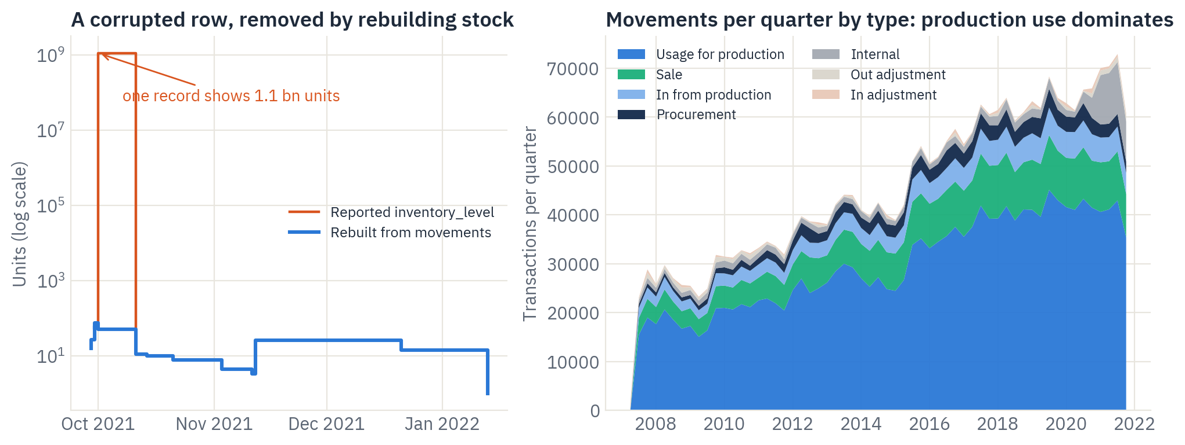
One bad row would have
put capital at 2.9 bn
PART 1 · DATA CLEANING
Why: proof that the stock history had to be rebuilt
units in one corrupted row
1.1 bn
of movements are production use
65%
6
Notes:
Left: one cheap article whose reported stock jumps to 1.1 billion units in a single corrupted row. Taken at face value, it would inflate 2021 capital from about 8 million to almost 2.9 billion. The rebuilt stock, in blue, stays in a normal range. Right: what the business is. 65 percent of all movements are usage for production, so most stock feeds the company’s own production rather than retail sales. That matters for strategy: a stockout often stops production, not just a sale.

Slide 7
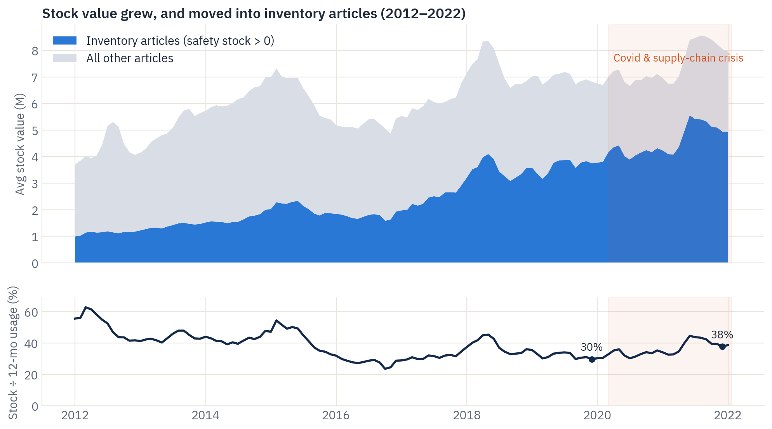
Stock grew faster than demand,
and a third is unmanaged
PART 1 · WHERE THE CAPITAL SITS
Why: shows where the money is tied up
stock in inventory articles since 2018
+39%
of a year’s usage held as stock
30% → 38%
of stock has no reorder point
37%
7
Notes:
Capital moved into the inventory articles: their stock value rose from 3.5 million in 2018 to 4.9 million in 2021, plus 39 percent, and their share of all stock went from 48 to 62 percent. Stock also grew faster than usage: from 30 to 38 percent of a year’s usage. And 37 percent of all stock value, 2.9 of 7.9 million, sits in articles without any reorder point: stock that no rule controls. That is exactly what the classification has to address.

Slide 8
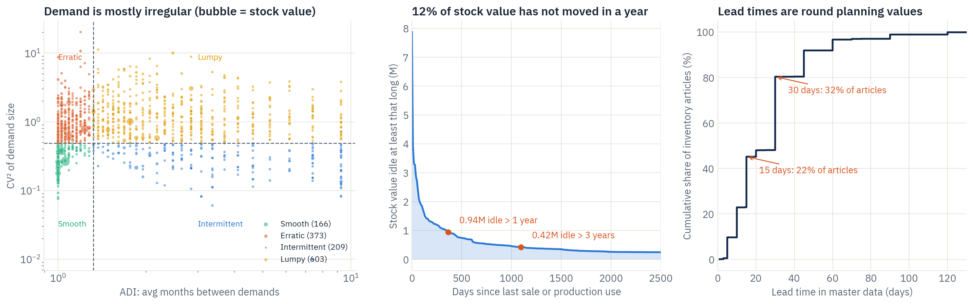
One formula cannot
fit this range
PART 1 · DEMAND, IDLE STOCK, LEAD TIMES
Why: these three facts shape the solution
90%
0.94M
54%
of stock articles have irregular demand
idle for more than a year
of lead times are exactly 15 or 30 days
8
Notes:
Three findings shape the solution. Left: demand is mostly irregular. Only 166 inventory articles, about 10 percent, have smooth demand; the rest are erratic, lumpy, intermittent or sporadic. On 5 percent of demand days, rare large orders carry 29 percent of volume. So one textbook safety-stock formula cannot fit all articles. Middle: 12 percent of stock value, 0.94 million, has not moved for a year, 0.42 million of it for three years or more; 318 articles keep a reorder point despite no demand for over a year. Right: lead times are planning values. 54 percent sit on exactly 15 or 30 days, and there are no order dates, so their real variability cannot be measured. We therefore stress-test lead times in Part 3.

Slide 9


Three classifications,
three decisions
HOW WE CLASSIFY ARTICLES
Why: one grouping cannot answer three different questions
1 · CLUSTERS · PART 2
2 · DEMAND PATTERN · PART 3
3 · ABC · PART 3
Stock it at all?
Which formula?
How much buffer?
Runners · Repeaters · One-offs · Dormant
Smooth · Erratic · Intermittent · Lumpy
A · B · C by usage value
→ stock, to order or phase out
→ how the reorder point is computed
→ fill target 98% / 95% / 90%
HOW ONE ARTICLE FLOWS THROUGH THEM
Article
Cluster
Pattern
ABC
Reorder point
any of 20,890
stock it? if yes →
pick the formula
set the target
+ safety stock
9
Notes:
We use three classifications, and each answers a different question, so they complement rather than compete. First, the four clusters from Part 2, built on demand behaviour with K-means, decide whether an article belongs on stock at all: stock, stock selectively, buy to order, or phase out. Second, the demand pattern, the Syntetos–Boylan scheme based on how often demand arrives, ADI, and how much its size varies, CV squared, decides which reorder-point formula is valid: the normal formula only works for smooth and erratic demand, so intermittent and lumpy articles use the distribution of their own past lead-time demand. Among the 1,751 inventory articles: Lumpy 603, Erratic 373, Intermittent 209, Smooth 166, Sporadic 148, no demand 252. Third, ABC by 12-month usage value, cut at 80 and 95 percent, sets the service target: 98, 95 or 90 percent fill.

Slide 10
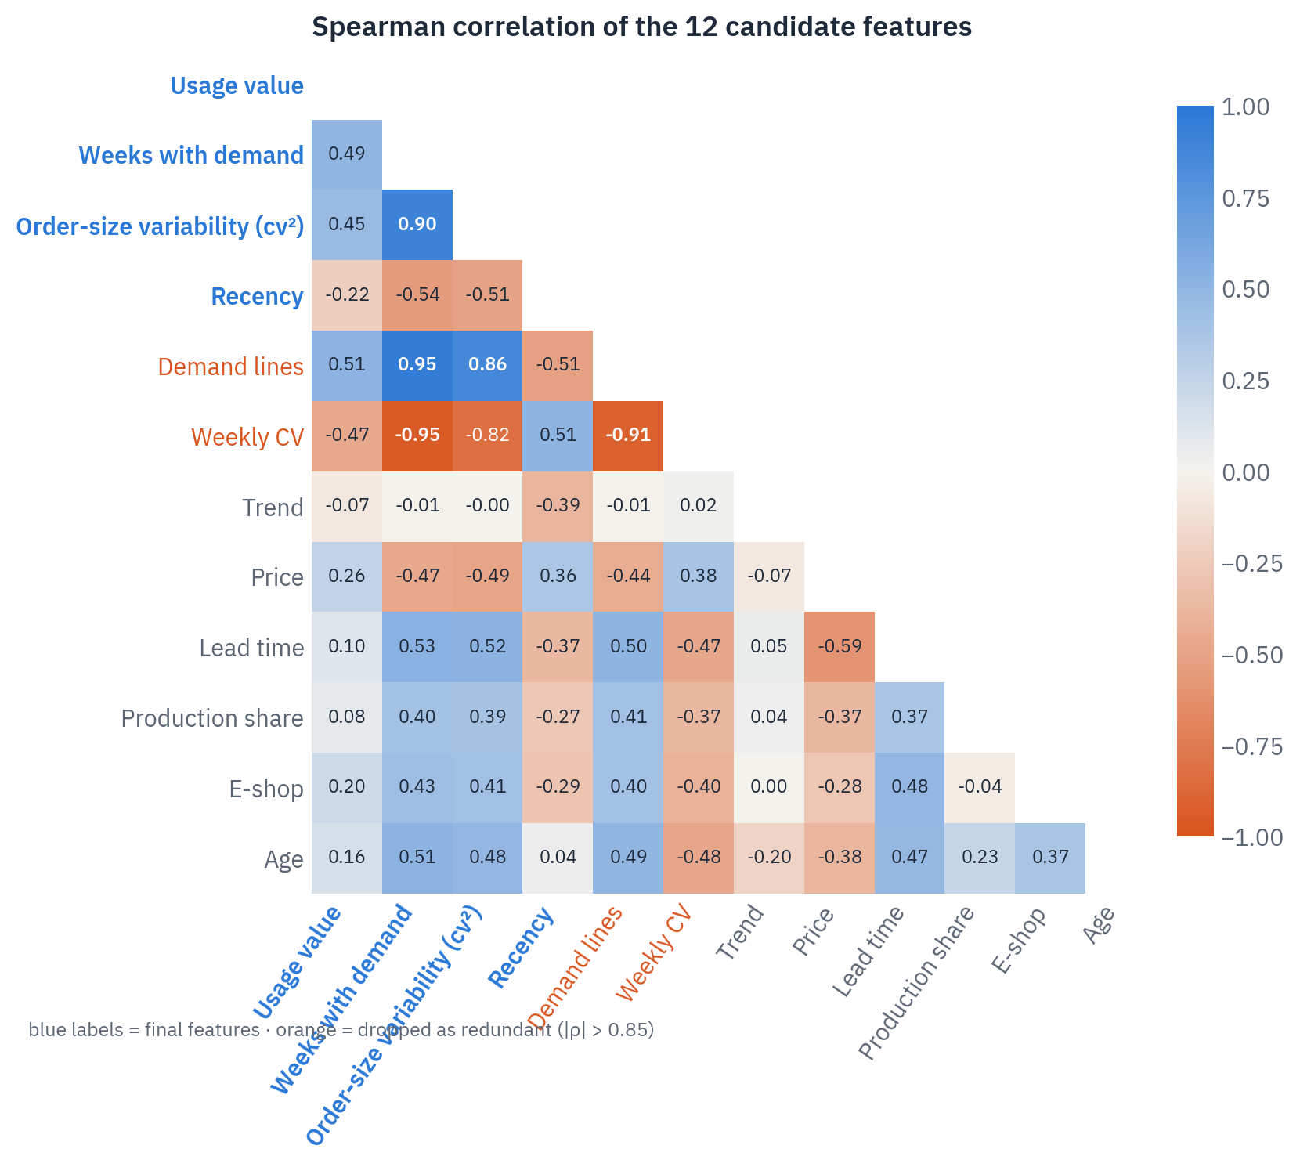
From 12 candidate
features to 4
PART 2 · FEATURE SELECTION
Why: keep only features that drive stocking, without overlap
12
candidate features
10
after removing overlaps (|ρ| > 0.85)
4
after business screen
10
Notes:
We started with twelve candidate features describing value, frequency, variability, recency, price, lead time, trend, product type, e-shop and age. The correlation matrix on the left shows which ones overlap. A redundancy filter removes one of every pair with Spearman rho above 0.85: number of demand lines and weekly CV go. We deliberately kept order-size variability: its correlation of 0.90 with frequency is an artefact of one-time demand, where CV squared is zero by definition, and drops to 0.49 for articles with three or more demand weeks. A business screen then removes lead time, which would leak today’s stocking decision, price, which is already inside usage value, product type, e-shop and age, which only describe the classes, and trend, which is noisy for low-volume articles. Four features remain: usage value, weeks with demand, order-size variability and days since last demand.

Slide 11
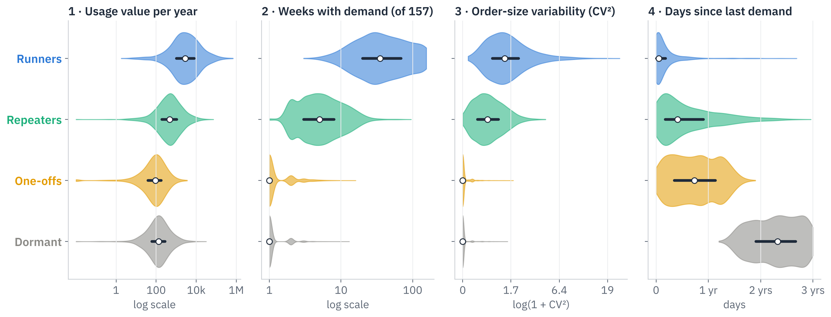
Each class has a clear
demand fingerprint
PART 2 · THE FOUR FEATURES
Why: shows the clusters differ for real, on every feature
1 · Usage value
2 · Weeks with demand
3 · Size variability
4 · Recency
money flowing through it
how regularly it is needed
how predictable each order is
is it still alive?
11
Notes:
The four clustering features, defined. Usage value: units used per year times purchase price, how much money flows through the article. Weeks with demand: number of weeks out of 157 with any demand, how regularly it is needed. Order-size variability: the squared coefficient of variation of non-zero order sizes, how predictable each order is. Recency: days since last demand up to 21 January 2022, whether the article is still alive. Each violin shows the full distribution per class; the white dot is the median and the dark bar the middle half of articles. Two features separate almost perfectly: weeks with demand splits Runners and Repeaters from the rest, and recency splits One-offs from Dormant. All four are log-scaled where skewed and standardised before K-means so that no feature dominates.

Slide 12
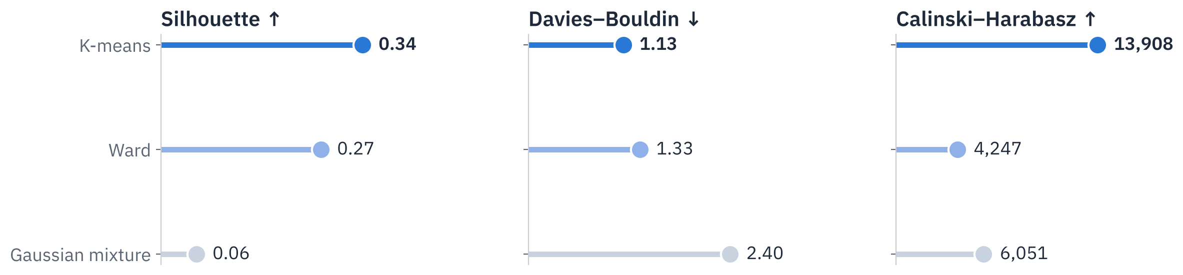
K-means with 4 classes
scores best and is stable
PART 2 · CHOOSING THE ALGORITHM
Why: proves the classes are robust, not an artefact
stability across 20 bootstrap refits
classic ABC-XYZ cannot separate this range
keeps frequent and occasional articles apart
0.98
98% Z
k = 4
12
Notes:
We compared three clustering algorithms with four classes on three quality metrics, and K-means wins on all of them: silhouette 0.34 against 0.27 for Ward and 0.06 for a Gaussian mixture; Davies–Bouldin 1.13, lower is better; Calinski–Harabasz 13,908. Ward was run on an 8,000-article sample. Three classes score marginally higher on silhouette, 0.35, but merge frequent and occasional articles that need different strategies, so we keep four. We also tested pure silhouette maximisation: it kept the binary e-shop flag and dropped usage value, statistically tidy but useless for stocking. The classes are stable: refitting on 20 bootstrap samples gives an adjusted Rand index of 0.98, minimum 0.96. The classic XYZ benchmark puts 98 percent of articles in Z, so ABC-XYZ cannot separate this range. A random forest shows what separates our classes: recency, then variability, then usage value, then frequency.

Slide 13
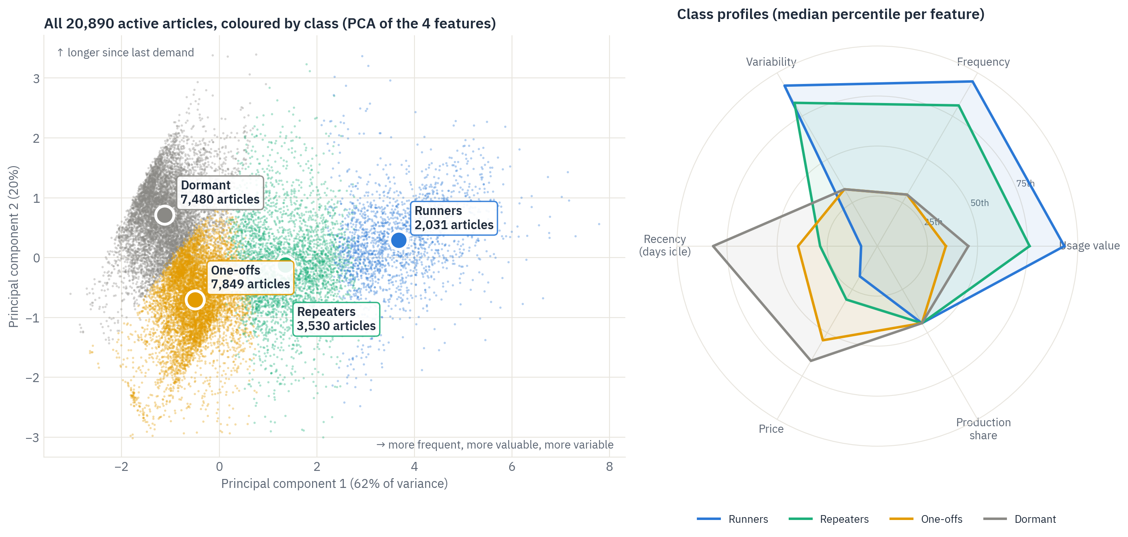
Four classes,
separated by usage and by recency
PART 2 · THE FOUR CLUSTERS
Why: each dot is one article; where it sits shows how it behaves
13
Notes:
Each dot is one of the 20,890 active articles, placed by a principal component analysis of the four features. The horizontal axis, 62 percent of the variance, runs from rarely used, low-value articles on the left to frequent, high-value ones on the right. The vertical axis, 20 percent, is recency. Runners sit far right, Dormant articles top left, One-offs bottom left, Repeaters in between. The radar on the right shows each class’s median percentile on six features; the classes also differ on features the model never saw: One-offs and Dormant articles are the most expensive per unit, while Runners are cheap and often used in production.

Slide 14
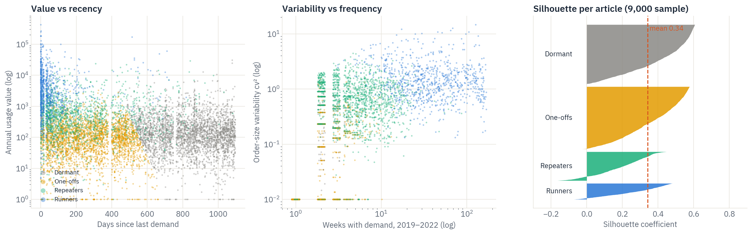
Repeaters sit between
regular and one-time demand
PART 2 · THE CLUSTERS UP CLOSE
Why: explains why Repeaters need a selective rule
Runners:
One-offs, Dormant:
Repeaters:
recent and high value
a single order
the transition zone
14
Notes:
Three views of the same classes. Left, value against recency: Runners cluster in the recent, high-value corner; Dormant articles start where demand stopped about 14 months ago. Middle, variability against frequency: One-offs and Dormant articles have one or two orders and therefore zero variability; Repeaters order a few times a year with variable sizes; Runners order weekly. Right, the silhouette of each article: the mean is 0.34; Dormant, 0.41, and One-offs, 0.37, are the cleanest classes; Repeaters, 0.19, are the transition zone between occasional and regular demand, which is why their strategy is selective rather than all-or-nothing.

Slide 15
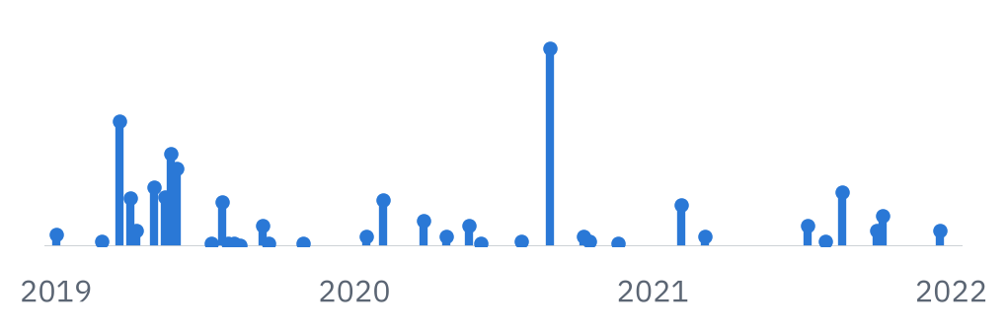
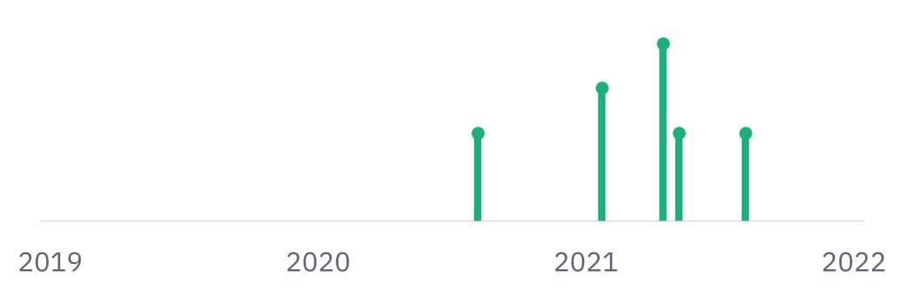
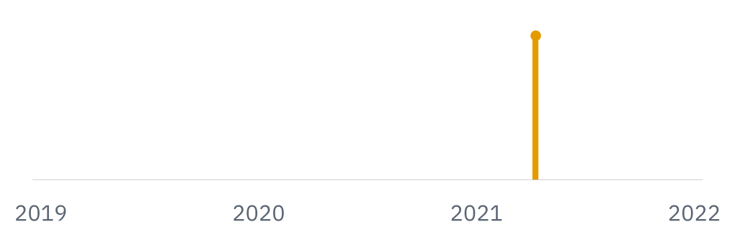
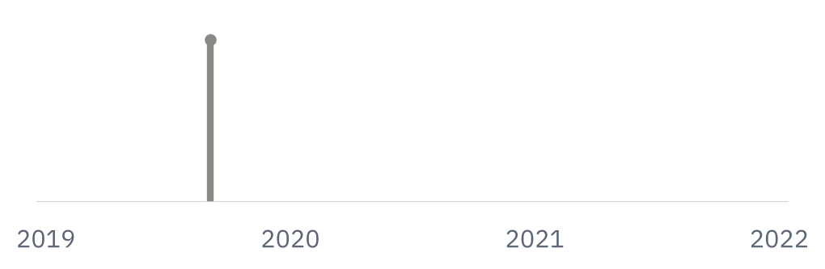
Different demand,
so a different way to supply it
PART 2 · STRATEGY PER CLASS
Why: the strategy follows directly from how each class behaves
Runners
Repeaters
One-offs
Dormant
10% of articles · 74% of usage
17% · 14% of usage
38% · 4% of usage
36% · 8% of usage
Why: frequent and valuable: a stockout stops sales or production
Why: a buffer would sit idle most of the year
Why: one order in 3 years, expensive per unit
Why: no demand for over a year
→ Stock, demand-driven ROP
→ Stock only if supplier is slow
→ Buy to order
→ Phase out
15
Notes:
Each class, and why its strategy follows from its demand. Runners: 2,031 articles, 10 percent of the active range but 74 percent of usage value; around 17 orders a year, last used about three weeks ago, cheap per unit, 37 percent mainly used in production. A stockout hurts and a buffer turns over quickly, so they are stocked with a demand-driven reorder point and a service target by value. Repeaters: 3,530 articles, about 2 orders a year in lumpy sizes, last used about five months ago. A permanent buffer would sit idle most of the year, so we stock them only where the supplier’s lead time is longer than the customer is willing to wait, with a lower target of about 90 percent. One-offs: 7,849 articles, one order in three years, expensive per unit, last used about nine months ago. Holding them is paying to wait for a repeat that may never come, so they are bought or produced to order without safety stock. Dormant: 7,480 articles with no demand for over 14 months, median 2.3 years. The remaining stock is at risk of obsolescence, so we stop replenishing and sell off or write it down.

Slide 16
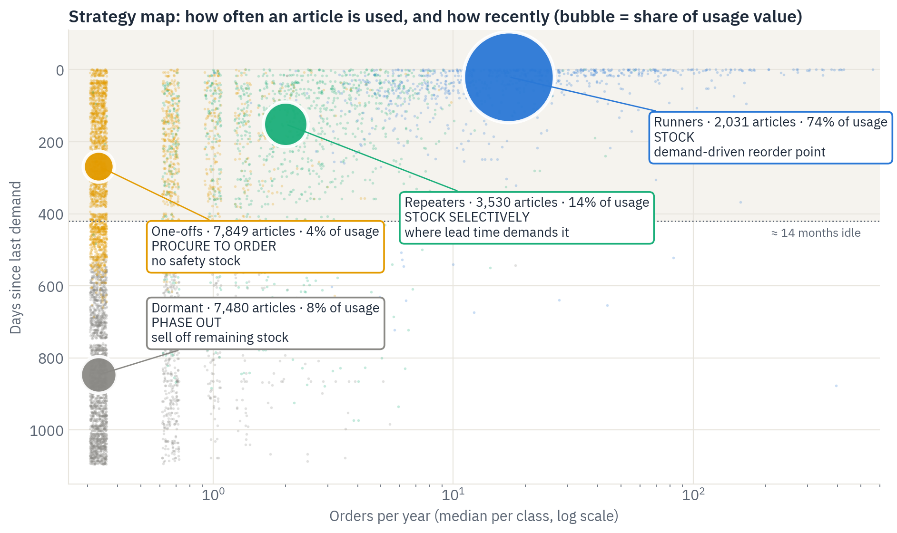
Only Runners and selected
Repeaters belong on stock
PART 2 · WHAT CHANGES FOR THE CLIENT
Why: turns the classes into concrete actions
stock articles to de-list
427
Runners still without a reorder point
1,052
re-classification keeps it current
Quarterly
16
Notes:
The strategy map places each class by how often it is ordered and how long ago it was last used; bubble size is its share of usage value. What changes for the client: de-list 427 stock articles, that is 175 stocked One-offs and Dormant articles plus 252 stocked articles without any demand in three years. Review the 1,052 Runners that have no reorder point today; only 18 percent of them are mainly used in production, so most are candidates for proper stock management rather than ad-hoc buying. Repeaters need a rule, not a default. And the class becomes master data, recomputed every quarter, so articles that slow down move from Runners to Repeaters to Dormant automatically.

Slide 17

ABC decides how much buffer
a stocked article gets
PART 3 · SERVICE LEVELS
Why: protect the articles where a stockout costs most
Class | Usage value | Articles | Fill target
A | top 80% | 167 | 98%
B | next 15% | 273 | 95%
C | last 5% | 1,311 | 90%
A-articles: share of articles → share of capital
10% → 65%
each target reached at least capital
Calibrated
Share of articles
A 10%
B 16%
C 75%
Share of capital
A 65%
B 15%
C 20%
17
Notes:
ABC is the classic Pareto cut: rank the 1,751 inventory articles by twelve-month usage value, that is usage times purchase price, add up their shares and cut at 80 and 95 percent. The top 80 percent of value is A, 167 articles; the next 15 percent B, 273 articles; the rest C, 1,311 articles including those without usage. A-articles are about 10 percent of the articles but hold about 65 percent of stock capital, and a stockout there costs most, so they get the highest target, 98 percent, and the pilot. C-articles are many but cheap, so a 90 percent target saves capital at little risk. In the simulation we calibrated the safety parameter per class on 2020 data as the smallest value that reaches each target. Remember the difference to Part 2: the cluster decides if we stock an article, ABC decides how safely.

Slide 18
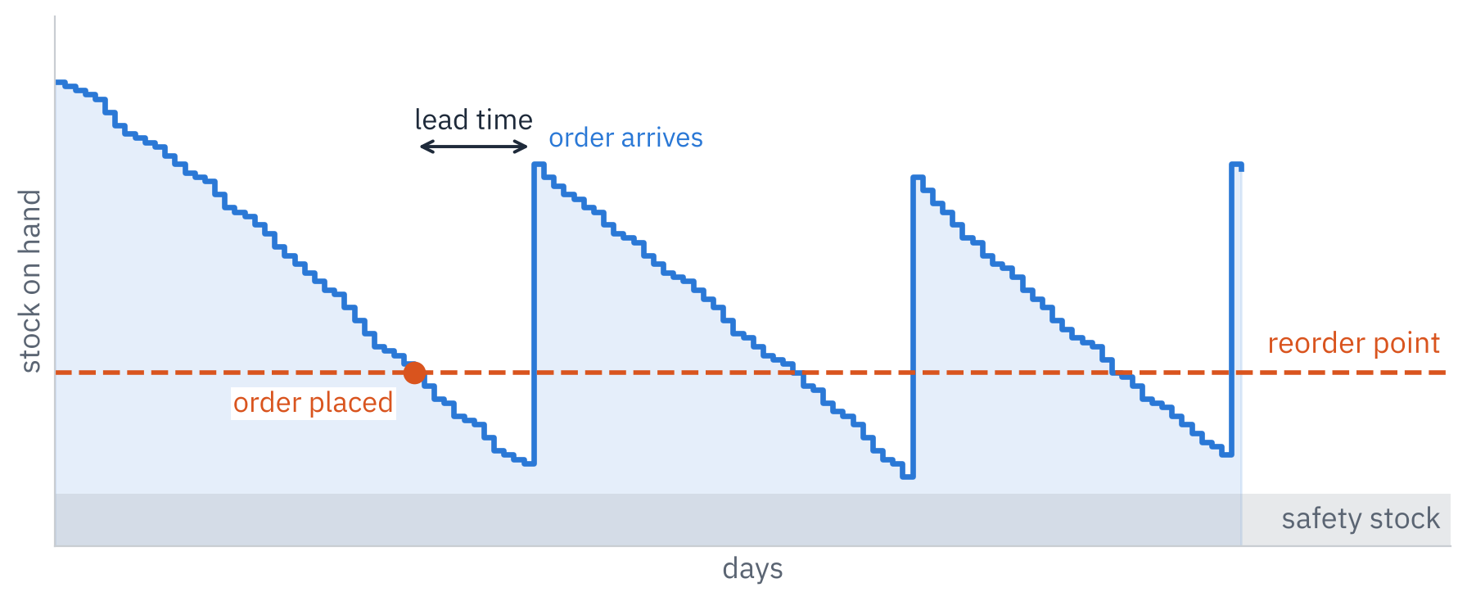
Prove the impact before
changing 1,751 settings
PART 3 · WHY SIMULATE
Why: a number per article is not proof of what it does
Formulas alone can’t be trusted
History can’t be replayed
Proof before change
75% irregular demand, large orders, MOQs
planners overrode the settings by hand
test on a year the method never saw
THE CASE FORMULA, TESTED
Case formula
SS = σ of demand
ROP = Quantity ÷ 360 × LT + SS
85% fill · 2.43M
Ours: same structure + service level per ABC class
ROP = μ·LT + z(p)·σ·√(LT/7)
irregular demand: p-quantile of LT demand
1
real daily demand, 2021
2
order at reorder point
3
delivery after lead time
4
measure stock and fill
95% fill · 3.65M
No lead time: case rule, usage 12 months ÷ 4 (31 articles)
18
Notes:
Why simulate at all? Three reasons. First, a formula alone cannot be trusted here: 75 percent of inventory articles have irregular demand, orders are large and the minimum order quantity binds, so textbook formulas give levels whose real effect on stock and service is unknown. Second, history cannot simply be replayed: planners overrode the reorder points by hand, and recorded service is censored, because usage is only booked when stock exists, so the recorded 99.6 percent fill says little. Third, the client needs proof before changing 1,751 settings. The case itself gives a starting formula on slide 11: safety stock equals the standard deviation of demand, and the reorder point equals the yearly quantity divided by 360, times the lead time, plus that safety stock. We implemented it exactly and simulated it on 2021 alongside our own policy. It reaches 85 percent fill at 2.43 million average stock, so it is a sensible starting point, but it has no service-level setting, so it cannot protect A-articles more than C-articles, and with irregular demand the standard deviation is inflated by rare large orders. Our formula keeps the same structure, demand over the lead time plus a buffer, but adds a service level per ABC class and, for irregular demand, uses the actual history of demand over the lead time instead of the standard deviation. That is what lifts fill to 95 percent at 3.65 million. For the 31 stock articles without a lead time in the master data, we follow the case instruction and keep the procurement rule: usage of the last 12 months divided by four. How it works: every day, for all 1,751 articles in parallel, the real 2021 base demand is taken from stock and unmet demand is back-ordered. When stock plus open orders falls to the reorder point, an order of today’s typical size, at least the MOQ, is placed and arrives after the article’s lead time. Rare large orders, daily demand above Q3 plus 3 IQR, are procured to order. The demand-driven policy recalculates each reorder point monthly on the last 365 days: mu times LT plus z sigma root of LT over 7 for steady demand, the p-quantile of past lead-time demand for irregular demand. Safety stock is the reorder point minus mu times LT. Timeline without look-ahead: parameters from 2019 to 2020, service levels calibrated on 2020, results measured on 2021.

Slide 19
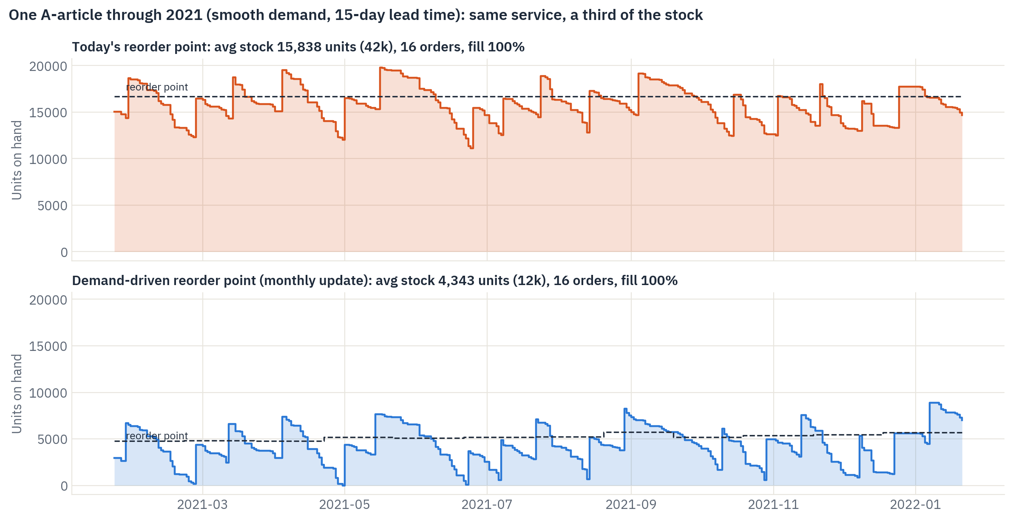
Same orders,
same 100% fill, 72% less stock
PART 3 · ONE ARTICLE, SIMULATED
Why: makes the mechanism visible on a real A-article
today’s reorder point vs need
3.2×
average units on hand
15,800 → 4,300
same orders, same 100% fill
16 orders
19
Notes:
One real A-article through 2021. Top: today’s reorder point of 16,661 units is 3.2 times what this article needs, so the warehouse carries about 15,800 units on average. Bottom: the demand-driven reorder point follows demand month by month and carries about 4,300 units. Same number of orders, 16, same full availability, but 72 percent less capital on this one article.

Slide 20
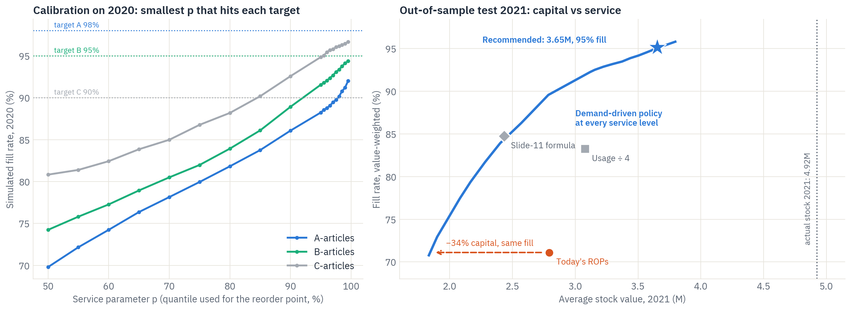
More service for less capital
than any current rule
PART 3 · CAPITAL VS SERVICE
Why: lets management pick a service level and see its cost
20
Notes:
Left, the calibration on 2020: for each ABC class, the simulated fill rate as the service parameter increases. We picked the smallest parameter that reaches each target: C reaches 90 percent at p equals 85 percent; A and B reach the best attainable level, 92 and 94 percent in 2020, at 99.5 percent; the gap comes from new, fast-growing articles that no history can anticipate. Right, the test year 2021: every point on the blue curve is the demand-driven policy at a different service level. It lies above all current rules: today’s reorder points, the usage divided by four rule and the case’s slide-11 formula. At the same 71 percent fill as today’s reorder points, it needs 34 percent less capital. The recommended point is 95 percent fill at 3.65 million, against 4.92 million actually held.

Slide 21
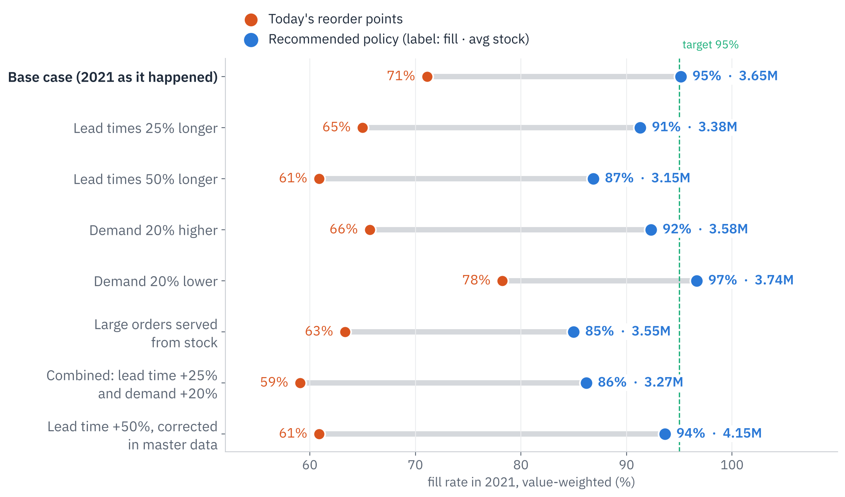
The strategy holds
when things go wrong
PART 3 · STRESS TEST
Why: a recommendation must survive bad lead times and demand shocks
fill in every scenario
≥ 85%
points ahead of today’s rules
+18 to +33
the main risk, fixed by correct master data
Lead times
21
Notes:
Why stress-test? A strategy that only works when everything goes to plan is not a recommendation. We re-ran the 2021 simulation under eight scenarios: lead times 25 and 50 percent longer than the master data says; demand 20 percent higher or lower than history; rare large orders served from stock instead of to order; a combined case with lead times 25 percent longer and demand 20 percent higher; and lead times 50 percent longer but corrected in the master data. Orange is today’s reorder points, blue the recommended policy, labelled with fill rate and average stock. The recommended policy never drops below 85 percent fill and stays 18 to 33 points ahead of today’s rules in every scenario, because it recalculates monthly and adapts to new demand. Today’s rules never reach 80 percent. The main vulnerability is lead time: if real lead times are 50 percent longer and nobody notices, fill drops to 87 percent; once the lead time is corrected in the master data, the policy recovers to 94 percent at 4.15 million, still below the 4.92 million actually held. So the stress test tells the client exactly which data to fix first.

Slide 22

From recommendation
to evidence
PART 3 · WHAT THE SIMULATION GAVE US
Why: four things a formula alone could not show
71%
3
−1.27M
8
Exposed today’s rules
Set service levels
Priced the impact
Tested the risks
the fill today’s reorder points really deliver
targets per ABC class, chosen on 2020 data
on 2021, a year the method never saw
stress scenarios, lead times first to fix
RESULT
One tested rule replaces 1,751 manual settings, with its cost known in advance
22
Notes:
To close Part 3, why the simulation was worth building. It did four things a formula alone cannot. One: it exposed today’s rules. Followed strictly, today’s reorder points give only 71 percent fill, which explains why planners top up by hand and why stock ended at 4.92 million. Two: it set the service levels. The safety parameter per ABC class was chosen on 2020 data as the smallest value reaching each target, so the least capital, no guessing. Three: it priced the impact on 2021, a year the method never saw: 95 percent fill at 3.65 million, so 1.27 million or 26 percent released and about 0.25 million a year saved in holding cost. Four: it tested the risks, with eight stress scenarios that show the policy holds and point to lead times as the data to fix first. Without a simulation, a formula gives a number per article but not what it does to stock and service when demand is lumpy, orders are large and MOQs bind. With it, management can pick any point on the capital–service curve and know its cost before changing 1,751 settings.

Slide 23
Stock the right articles,
at levels set by demand
RESULTS & RECOMMENDED STRATEGY
Policy, 2021 | Stock | Fill
Actual 2021 | 4.92M | –
Today’s rules | 2.79M | 71%
Usage ÷ 4 | 3.08M | 83%
Recommended | 3.65M | 95%
ROADMAP
M1
M2
M3
M4
M5
M6
1 · Clean the range
2 · Stock by class
3 · Levels from demand
4 · Protect the result
Step 3 starts with an A-article pilot · step 4 runs continuously
≈ 0.25M a year holding cost saved
−1.27M (−26%)
23
Notes:
Putting it together. In the test year, the recommended demand-driven policy holds 3.65 million on average against 4.92 million actually held, and reaches 95 percent fill, 97 percent on A-articles. For comparison, today’s reorder points followed strictly would give only 71 percent fill, the usage divided by four rule 83 percent, and the case’s slide-11 formula 85 percent at 2.43 million. That frees 1.27 million, 26 percent, and saves about 0.25 million a year in holding cost at an assumed 20 percent rate, 0.19 to 0.32 million at 15 to 25 percent. The roadmap: one, clean the range in months one to two by de-listing 427 articles and selling off or writing down 0.94 million of idle stock. Two, stock by class in months one to three. Three, replace manual reorder points with the demand-driven rule, recalculated monthly with targets A 98, B 95, C 90 percent, starting with the A-articles that hold about 65 percent of capital as a pilot. Four, protect the result: record order dates to measure real lead times, plan rare large orders through customer and production orders, and set order size together with the reorder point. 1,751 manual settings become one rule. Every article’s recommended level is in the Excel file in the repository.

Slide 24



Robust to the data gaps,
three points to validate
LIMITATIONS & NEXT STEPS
LIMITATIONS
NEXT STEPS
Master data is a 2022 snapshot
Agree service targets per class
No order dates to measure lead times
Validate A-article lead times
Holding cost rate of 20% assumed
Run a one-quarter A-article pilot
Recorded service history is censored
Thank you · Questions?
24
Notes:
Our results hold up against the main data gaps, but they have limits. Master data is a 2022 snapshot, so history is valued at today’s purchase price and compared with today’s settings. There are no order dates, so lead-time variability cannot be measured; the stress test bounds the risk, with 50 percent longer lead times giving 87 percent fill. The holding cost rate of 20 percent is an assumption; it only affects the yearly saving, not the capital figures. And recorded service is censored, because usage is only booked when stock exists, so service is compared inside the simulation, not against history. Values are anonymised: quantities carry a constant factor of 1.1107 and money is in dataset units; ratios and percentages are unaffected. Next steps with the client: agree service targets per class, validate lead times for the A-articles, run a one-quarter pilot on the A-articles compared against the simulation, and quantify the capital released by phasing out One-offs and Dormant articles. Everything is reproducible from the raw file in the repository. Thank you, I am happy to take questions.

